Slide 1
My grandparents
SARA BARÓN NAVAL

Slide 2
My mother’s grandparents were from Estadilla, my great- grandmother lived in the Carrodilla
Until she was 18 years owl. She rode a
horse and brought food to the workers
In the mountains.

Slide 3
Mi grandfather was born in Estadilla.
He studied music from a young age , apart from going to school and helping at home.
All his life he has been a musician and also a farmer.

Slide 4
My great-grandmother went to work as a servant in Barcelona at the age of 13 years owld
My grandmother was born in Estadilla .
To her in school in the afternoon they taught her to sew.

Slide 5
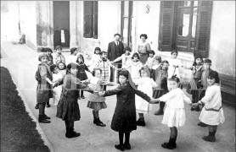
When my grandparents were children,
The girls and the boys were not together at school, neither in class nor on breaks.

Slide 6
When they left the school
They helped at home, whith the tasks that there were,
In the field, with the animals…

Slide 7
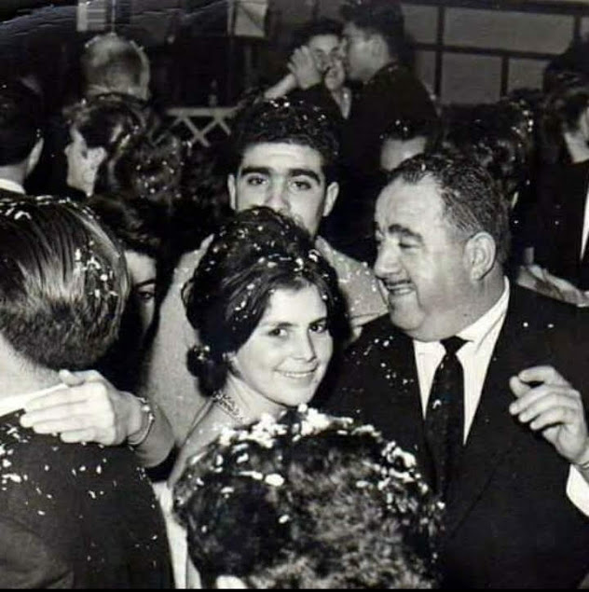
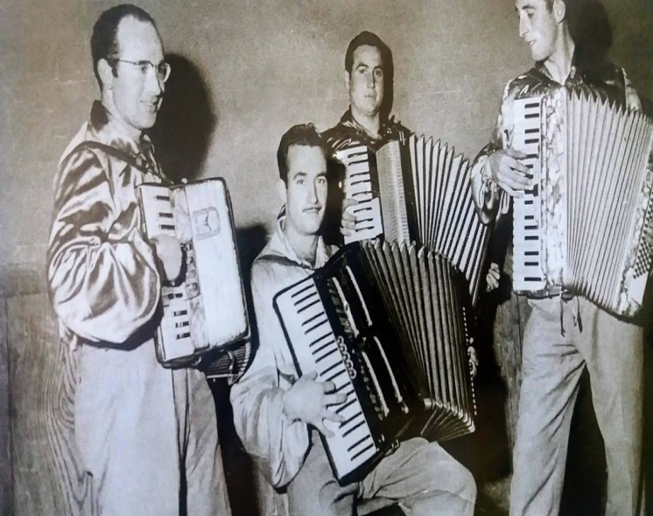
For fun, some Sundays used to dance, where the boys and girls
Would dance to meet eatch other

Slide 8
From my father, my grandmother was born
in Morocco in a Spanish colony.
They had animals and
thay sold milk and cheese. When she was
no longer Spanish they moved to Barcelona.

Slide 9
My grandfather lived
In Cáceres.
He worked in the fields and with animals. Some times
later his family moved to Barcelona
and there he met my
grandmother.

Slide 10
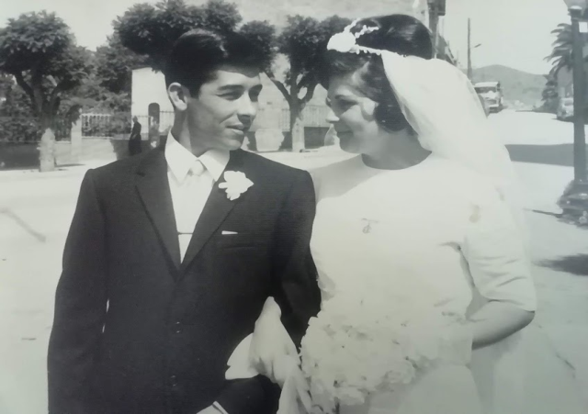
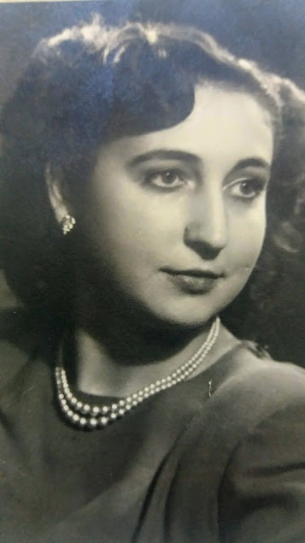
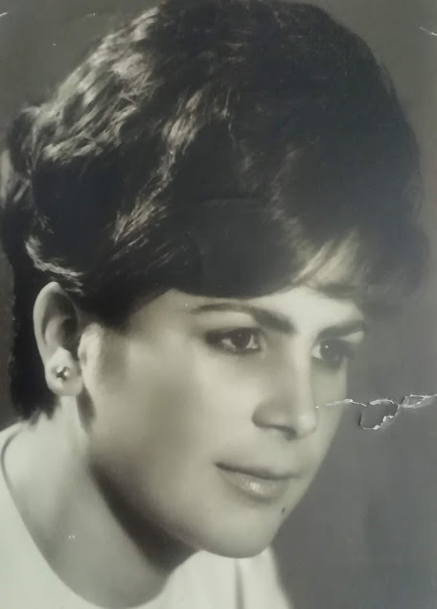
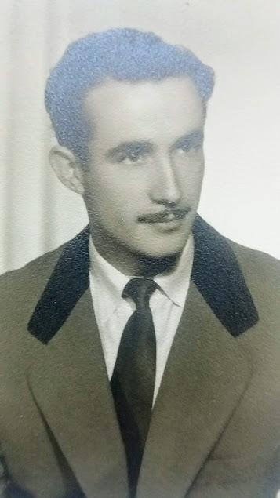
FIN

